Slide 1
Consumer Health Information Search @FIRE, 2016
Manjira Sinha, Sandya Mannarswamy, Shourya roy
Xerox research center india

Slide 2
Motivation
1 out of 20 searches in Google are on health related queries
Yet no mechanism to classify complex subjective consumer queries with ‘No single best answer’
'does treatment X effective for disease Y?‘
'can X cause disease Y'
CAN METABOLIC THERAPY CURE BRAIN CANCER?
Glucose is the primary fuel to cancer cells, hence low carb ketogenic diets can be effective in reducing growth of cancer cells in brain
American Society for Cancer does not recommend metabolic therapy as a viable treatment approach for brain cancer.

Slide 3
IS HONEY BETTER THAN SUGAR?
One tablespoon of table sugar or sucrose contains 46 calories, while one tablespoon of natural sweetener honey has 64 calories.
Sweeter than sugar and with twice the nutritional profile could honey be the ultimate alternative to table sugar?
DO VACCINES CAUSE AUTISM?
There is absolutely undeniable scientific proof that vaccines cause autism. There is no question! Case closed! Game over!
Many major medical groups say vaccines don't cause autism. Many parents say they do.

Slide 4
Challenges
They typically contains domain specific technical terms and abbreviations
E-cigarettes contain di-acetyl which has been associated with popcorn lung syndrome
The scientific language associated with these sentences presents these perspectives typically in a non-emotional, non-affective, neutral language, leading to a scarcity of sentiment/affect-bearing words.
Many studies have found that there are considerable evidences that skin cancer rates are increasing in indoor workers.
No reviews or research studies have determined that people who perform indoor jobs have higher rate of skin cancer.

Slide 5
Task Description
Given a health query and retrieved search results :
Task A: Classify the retrieved sentence as relevant to the query or not.
Task B: The relevant results are needed to be further classified as supporting the claim made in the query, or opposing the claim made in the query
Example:
“Are e-cigarettes safer than normal cigarettes?”
‘Because some research has suggested that the levels of most toxicants in vapor are lower than the levels in smoke, e-cigarettes have been deemed to be safer than regular cigarettes’.
A)Relevant, B) Support

Slide 6
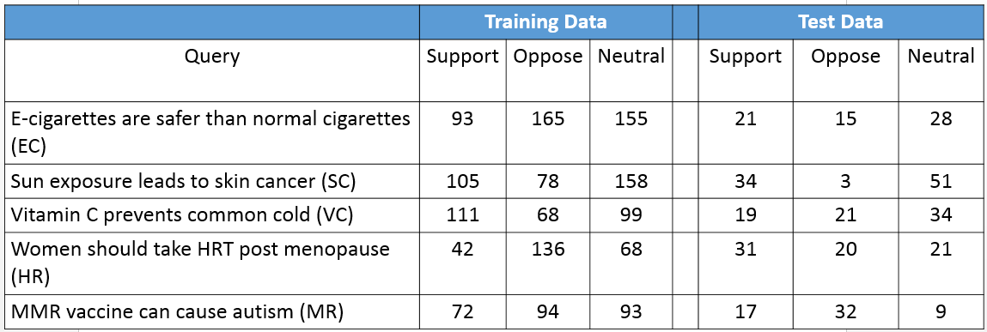
Task Data

Slide 7
Teams
Team Name | Team Members | Institute
Amrita_CEN | Remmiya devi G, Veena P V , Anand Kumar M and Soman K P | Amrita University, Coimbatore
Amrita_Fire_CEN | Barathi Ganesh HB, Dr. Anand Kumar M, Dr. Soman KP | Tata Consultancy Services, Kochi; Amrita Vishwa Vidyapeetham, Coimbatore
JNTUH | S Suresh Kumar, L Naveen | JNTU Hyderabad; BVRIT, Hyderabad
JU_KS_Group | Kamal Sarkar, Indra Banerjee, Debanjan Das, Mamta Kumari ,Prasenjit Biswas | Jadavpur University, Kolkata
Fermi | Vijayasaradhi, Subba Reddy | International Institute of Information Technology-Hyderabad (IIIT- H)
Techie-challengers | Raksha Jalan , Nikhil Priyatam Pattisapu, Vasudeva Varma | International Institute of Information Technology-Hyderabad (IIIT- H)
SSN_NLP | Dr. D. Thenmozhi, Dr. P. Mirunalini and Dr. C Aravindan | SSN College of Engineering, Chennai
Individual | Jainisha Shankhavara | DAIICT, Gandhinagar
Individual | Hua Yang, Teresa Gonçalves | University of Évora, Portugal

Slide 8
Results

Slide 9
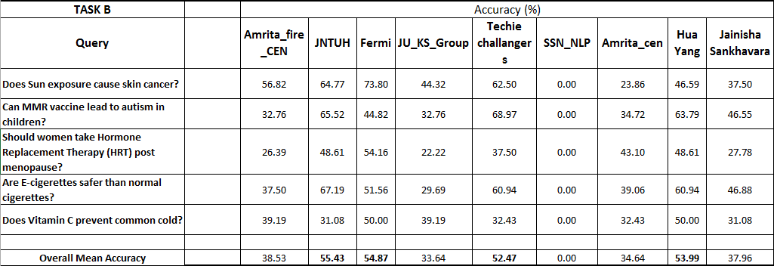
Results

Slide 10
Future Directions
Modeling over larger piece of text for capturing discourse relations
Incorporating medical knowledge bases in the inference mechanism
Pointer to the credibility of the claims
Development of gold standard annotated data.

Slide 11
Thank You
Contact: manjira87@gmail.com

