Slide 2
بسته پیشنهادی ارتقاء خط و زبان فارسی در محیط رایانه
Algorithms and Corpora for Persian Plagiarism Detection: Overview of PAN at FIRE 2016
Habibollah Asghari
ICT Research Institute, ACECR,
Tehran, Iran

Slide 3
Outline of Presentation
History of works in Persian PD activities
Persian Plagdet 2016
Evaluation Framework
Results of the Shared task

Slide 4
Persian Language Characteristics
Persian belongs to Arabic script-based languages share some common linguistic characteristics:
Absence of capitalization
Right to left direction
Lack of clear word boundaries
Complex word structure
Encoding issues in computer environment
A high degree of ambiguity due to non-representation of short vowels in the writing system
رانندگی$$درپر$$ازدحام$$ترین $$شهرما$$ اثر $$بخش $$نمی $$ باشد.

Slide 5
History of works in Persian Plagiarism Detection
1

Slide 6
Plagdet Activities in Iran
PlagDet Task at AAIC: The first competition on Persian plagiarism detection was held with the 3rd AmirKabir Artificial Intelligence Competition (AAIC 2015)
Results in the release of the first PD corpus in Persian
The PAN structure on evaluation and corpus annotation was used in this competition.

Slide 7
Lessons learned from AmirKabir AAIC
The low number of Participants
Importance of CFP
High rate of Withdraws
Free registration
Just local teams participate in Competition
Using an online platform to support remote participation
Unfamiliarity with rules and criteria
More effective communication with participants using Discussion groups and email
Problems with running the codes
Exploiting a unified Platform (TIRA) instead of running the codes on usesrs computers
Incentives for the participants
High ranked teams will be awarded
Holding a Local ceremony for introducing the award winners
Intellectual property of the corpora
Writing terms and conditions

Slide 8
Persian Plagdet 2016
2

Slide 9
Starting the shared task
Important Dates
Skype Meeting with PAN Organizers
May, 18, 2016
Starting Persian Plagdet 2016
Test Data Release
Aug, 22, 2016
Results Declared
Sept, 15, 2016
Letter of Request to PAN Organizers
Nov, 29, 2015
2015
Nov 2015
April 2016
May 2016
July 2016
August 2016
Sept 2016
Oct 2016
2016
Submitting the Proposal
April, 20, 2016
Run submission deadline
Sept, 1, 2016
Approve of the Proposal
May, 1, 2016
Training Data Release
July, 15, 2016
Working Notes Due
Oct, 15, 2016

Slide 10
Shared task Description
Subtask #1: Plagiarism Detection
To identify the similarity of text fragments between the pairs of suspicious document and the sources documents.
Subtask #2: Text Alignment Corpus Construction
The construction of text alignment plagiarism detection corpus. The corpus would be Persian mono-lingual or bi-lingual with the compound of Persian and any other languages.
The main objectives are:
Validating of Persian PD corpora.
To evaluate submitted corpora in order to rank them based on their quality.
The proposed PD systems of subtask#1 would be run on submitted corpora.

Slide 11
Main Challenges (Second subtask)
How to evaluate the corpora?
Finding some quality measures
Versatility in types of obfuscation
Tag correctness
Size of the corpus
Topic versatility
Existence of Real plagiarism (are they run a near duplicate code?)
Corpora ownership
Writing terms and conditions
Granting open source corpora

Slide 12
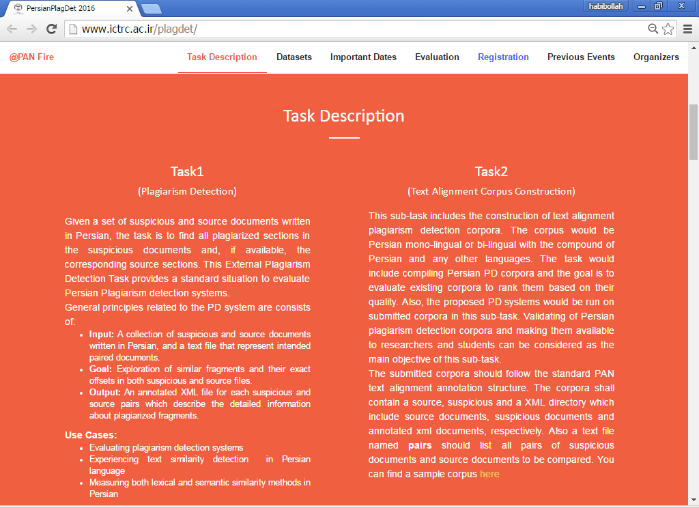
Launching the shared task website

Slide 13
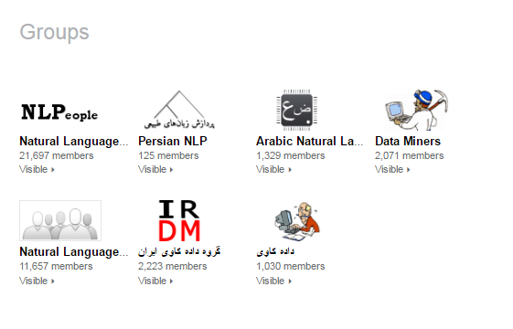
Call for Participation
Email of CFP to all role players in Iran
Sending CFP to Iranian Students in Universities Overseas
FIRE mailing list
CLEF mailing list
Dbworld mailing list
Corpora-list mailing list
PAN-AraPlagDet mailing list
Related NLP groups in Linkedin

Slide 14
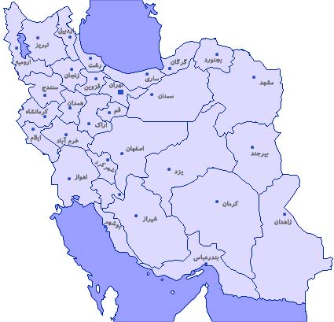
Participants
A total of 31 Teams were registered
Iran (23)
USA (1)
United Kingdom (2)
Germany (1)
Ukraine (1)
India (2)
Egypt (1)
Eleven teams in the final stage
Caspian Sea
Turkey
Afghanistan
Iraq
Pakistan
Persian Gulf
Participant groups

Slide 15
Evaluation Framework
3

Slide 16
Evaluation Framework
Corpus
Submission Platform
Evaluation Measure
TIRA Platform
PD Corpus
Plagdet (evaluation measure)
Crowd-Sourcing

Slide 17
Training Corpus Statistics
Corpus Statistics
Entire corpus | Number of documents | 5830
 | Number of plagiarism cases | 4118
Document purpose | Source documents | 48%
 | Suspicious documents | 52%
Document length | Short (1-500 words) | 35%
 | Medium (500-2500 words) | 59%
 | Long (2500-21000 words) | 06%
Plagiarism per Document | Small (5% - 20%) | 57%
 | Medium (21% - 50%) | 15%
 | Much (50% - 80%) | 18%
 | Entirely (>80%) | 10%
Plagiarism Case Statistics
Obfuscation | Number of cases | 1628
 | None (exact copy) | 11%
 | Artificial Low High | 81% 40% 41%
 | Simulated | 08%
Case length | Short (30 - 50 words) | 35%
 | Medium (100-200 words) | 38%
 | Long (200-300 words) | 27%
The statistics of the training corpus is almost the same as PAN, but the length of the documents are about 10% larger than that of PAN

Slide 18
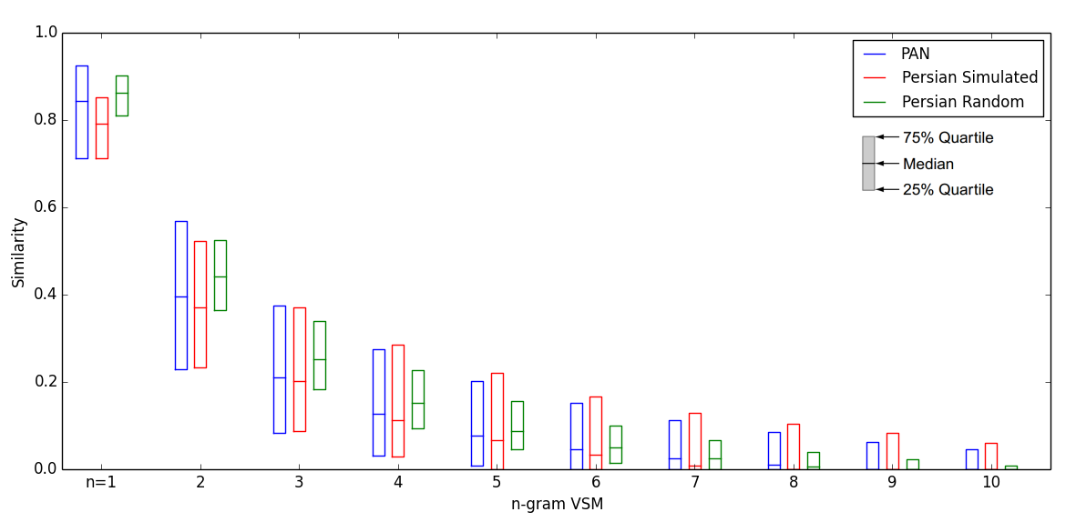
Training Corpus Statistics

Slide 19
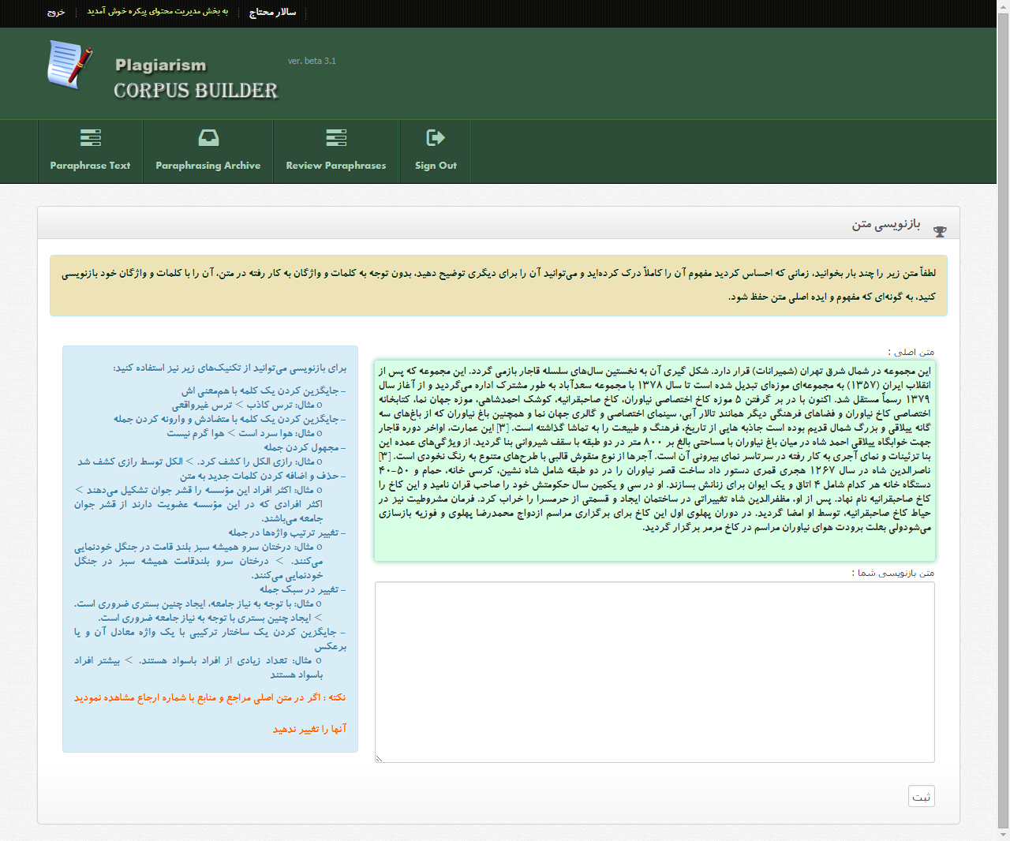
Crowd sourcing Platform
Two Criteria for removing poor quality plagiarized passages (~10%) :
The resulted passage is very shorter than the original one
The resulted passage is too similar to the original one

Slide 20
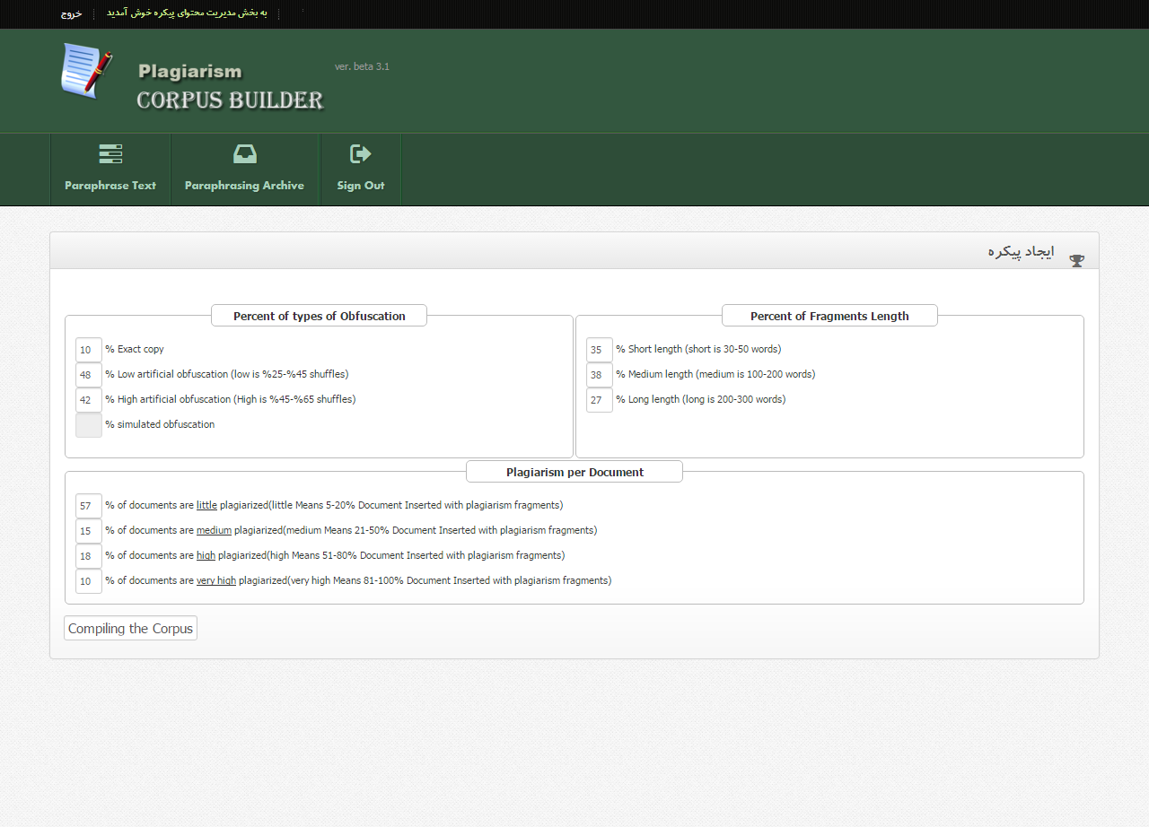
Crowd Sourcing Platform
Corpus Builder Tuning
20

Slide 21
Crowd workers’ Demographics
Workers’ Demographics
Age | 25 – 30 | 41%
 | 30 – 40 | 38%
 | 40 – 58 | 21%
Education | College | 05%
 | BSc. | 25%
 | MSc. | 58%
 | PhD | 12%
Tasks per worker | Average | 19.0
 | Std. deviation | 14.5
 | Minimum | 01
 | Maximum | 54
Gender | Male | 74%
 | Female | 26%
21

Slide 22
TIRA EaaS Platform
Provides virtual machines allows for convenient deployment and execution
A variety of operating Systems available to participants
TIRA offers a convenient web GUI that allows self-evaluate
TIRA allows for multiple evaluation of submitted software against test datasets in the future, improving reproducibility
22

Slide 23
Results of the Subtask #1
4
23

Slide 24
Results of Subtask #1
Overall detection performance for the nine approaches submitted.
Rank / Team | Runtime (h:m:s) | Recall | Precision | Granularity | F-Measure | PlagDet
1 Mashhadi | 02:22:48 | 0.9191 | 0.9268 | 1.0014 | 0.9230 | 0.9220
2 Gharavi | 00:01:03 | 0.8582 | 0.9592 | 1 | 0.9059 | 0.9059
3 Momtaz | 00:16:08 | 0.8504 | 0.8925 | 1 | 0.8710 | 0.8710
4 Minaei | 00:01:33 | 0.7960 | 0.9203 | 1.0396 | 0.8536 | 0.8301
5 Esteki | 00:44:03 | 0.7012 | 0.9333 | 1 | 0.8008 | 0.8008
6 Talebpour | 02:24:19 | 0.8361 | 0.9638 | 1.2275 | 0.8954 | 0.7749
7 Ehsan | 00:24:08 | 0.7049 | 0.7496 | 1 | 0.7266 | 0.7266
8 Gillam | 21:08:54 | 0.4140 | 0.7548 | 1.5280 | 0.5347 | 0.3996
9 Mansourizadeh | 00:02:38 | 0.8065 | 0.9000 | 3.5369 | 0.8507 | 0.3899
24

Slide 25
Results of Subtask #1
Detection performance of submitted runs dependent on obfuscation type
Team | No obfuscation (Verbatim Copy) |  |  |  |  | Artificial Obfuscation |  |  |  |  | Simulated Obfuscation
 | Recall | Precision | Granularity | PlagDet |  | Recall | Precision | Granularity | PlagDet |  | Recall | Precision | Granularity | PlagDet
Mashhadirajab | 0.9939 | 0.9403 | 1 | 0.9663 |  | 0.9473 | 0.9416 | 1.0006 | 0.9440 |  | 0.8045 | 0.9336 | 1.0047 | 0.8613
Gharavi | 0.9825 | 0.9762 | 1 | 0.9793 |  | 0.8979 | 0.9647 | 1 | 0.9301 |  | 0.6895 | 0.9682 | 1 | 0.8054
Momtaz | 0.9532 | 0.8965 | 1 | 0.9240 |  | 0.9019 | 0.8979 | 1 | 0.8999 |  | 0.6534 | 0.9119 | 1 | 0.7613
Minaei | 0.9659 | 0.8663 | 1.0113 | 0.9060 |  | 0.8514 | 0.9324 | 1.0240 | 0.8750 |  | 0.5618 | 0.9110 | 1.1173 | 0.6422
Esteki | 0.9781 | 0.9689 | 1 | 0.9735 |  | 0.7758 | 0.9473 | 1 | 0.8530 |  | 0.3683 | 0.8982 | 1 | 0.5224
Talebpour | 0.9755 | 0.9775 | 1 | 0.9765 |  | 0.8971 | 0.9674 | 1.2074 | 0.8149 |  | 0.5961 | 0.9582 | 1.4111 | 0.5788
Ehsan | 0.8065 | 0.7333 | 1 | 0.7682 |  | 0.7542 | 0.7573 | 1 | 0.7557 |  | 0.5154 | 0.7858 | 1 | 0.6225
Gillam | 0.7588 | 0.6257 | 1.4857 | 0.5221 |  | 0.4236 | 0.7744 | 1.5351 | 0.4080 |  | 0.2564 | 0.7748 | 1.5308 | 0.2876
Mansourizadeh | 0.9615 | 0.8821 | 3.7740 | 0.4080 |  | 0.8891 | 0.9129 | 3.6011 | 0.4091 |  | 0.4944 | 0.8791 | 3.1494 | 0.3082
25

Slide 26
Results of the Subtask #2
5
26

Slide 27
TIRA EaaS Platform
Five Corpora Submitted
The source of the documents
journal and Conference papers
Wikipedia articles in Persian
Books and novels translated in Persian
Quantitative/Qualitative analysis of submitted corpora
Manually checking of submitted corpora
Offsets and length of Plagiarized passages according to PAN
27

Slide 28
Results of Subtask #2
Corpus validation
Corpus statistics for the submitted corpora
 |  | Niknam | Samim | Mashhadirajab | ICTRC | Abnar
Entire corpus | Number of documents | 3218 | 4707 | 11089 | 5755 | 2470
 | Number of plagiarism cases | 2308 | 5862 | 11603 | 3745 | 12061
Document purpose | Source documents | 52% | 50% | 48% | 49% | 20%
 | Suspicious documents | 48% | 50% | 52% | 51% | 80%
Document length | Short (1-10000 words) | 35% | 2% | 53% | 91% | 51%
 | Medium (10000-30000 words) | 56% | 48% | 32% | 8% | 48%
 | Long (> 30000 words) | 9% | 50% | 15% | 1% | 1%
Plagiarism per document | Hardly (<20%) | 71% | 29% | 39% | 57% | 29%
 | Medium (20%-50%) | 28% | 25% | 14% | 37% | 60%
 | Much (50%-80%) | 1% | 31% | 20% | 6% | 10%
 | Entirely (>80%) | - | 15% | 27% | - | 1%
Case length | Short (1-500 words) | 21% | 15% | 6% | 51% | 45%
 | Medium (500-1500 words) | 76% | 22% | 52% | 46% | 54%
 | Long (>1500 words) | 3% | 63% | 42% | 3% | 1%
Obfuscation types | No obfuscation (exact copy) | 25% | 40% | 17% | 10% | 22%
 | Artificial (word replacement) | 27% | - | - | - | -
 | Artificial (synonym replacement) | 25% | - | - | - | -
 | Artificial (POS-preserving shuffling) | 23% | - | - | - | -
 | Random | - | 40% | - | 81% | -
 | Semantic | - | 20% | - | - | 15%
 | Near Copy | - | - | 28% | - | -
 | Summarizing | - | - | 33% | - | -
 | Paraphrasing | - | - | 6% | - | -
 | Modified Copy | - | - | 4% | - | -
 | Circle Translation | - | - | 3% | - | 21%
 | Semantic-based meaning | - | - | 1% | - | -
 | Auto Translation | - | - | 2% | - | -
 | Translation | - | - | 6% | - | -
 | Simulated | - | - | - | 9% | -
 | Shuffle Sentences | - | - | - | - | 21%
 | Combination | - | - | - | - | 21%
28

Slide 29
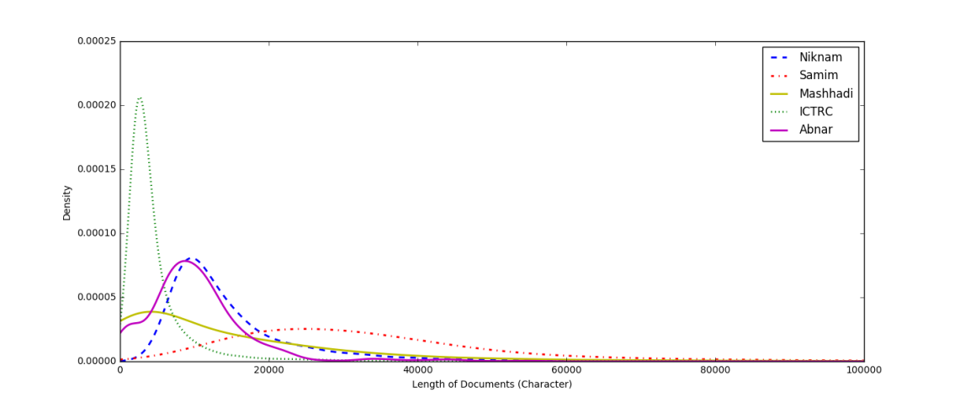
Results of Subtask #2
Corpus validation
Length distribution of documents
29

Slide 30
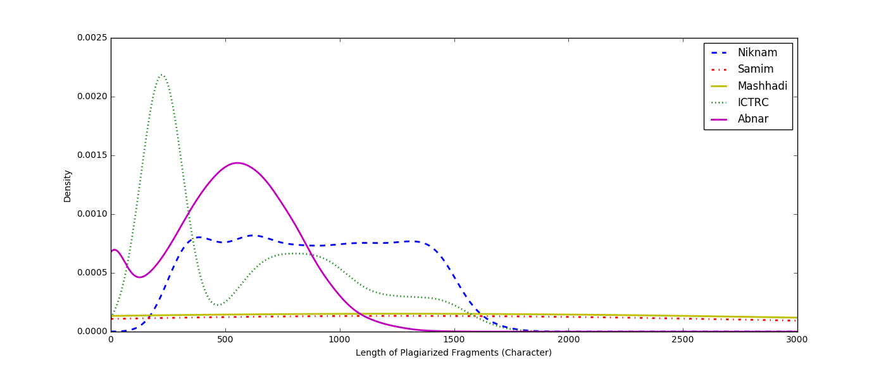
Results of Subtask #2
Corpus validation
Length distribution of fragments
30

Slide 31
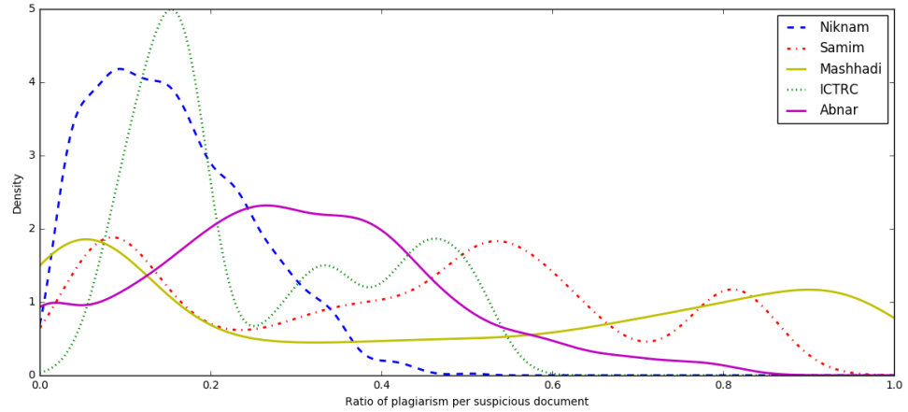
Results of Subtask #2
Corpus validation
Ratio of plagiarism per document.
31

Slide 32
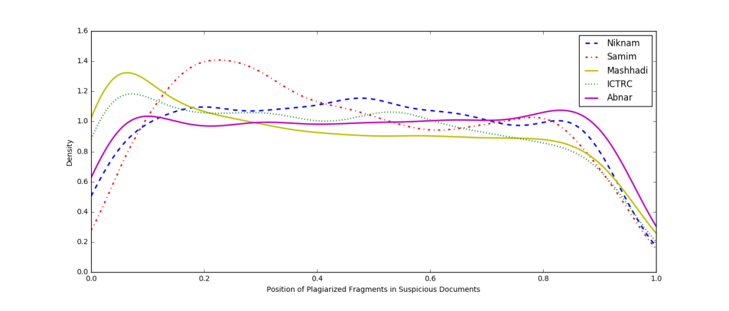
Results of Subtask #2
Corpus validation
Start position of plagiarized fragments in suspicious documents
32

Slide 33
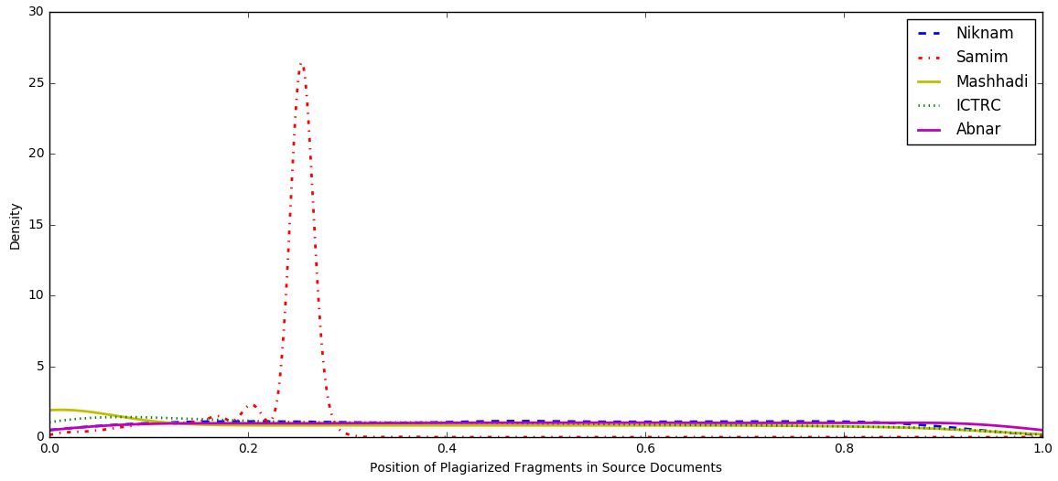
Results of Subtask #2
Corpus validation
Start position of plagiarized fragments in source documents.
33

Slide 34
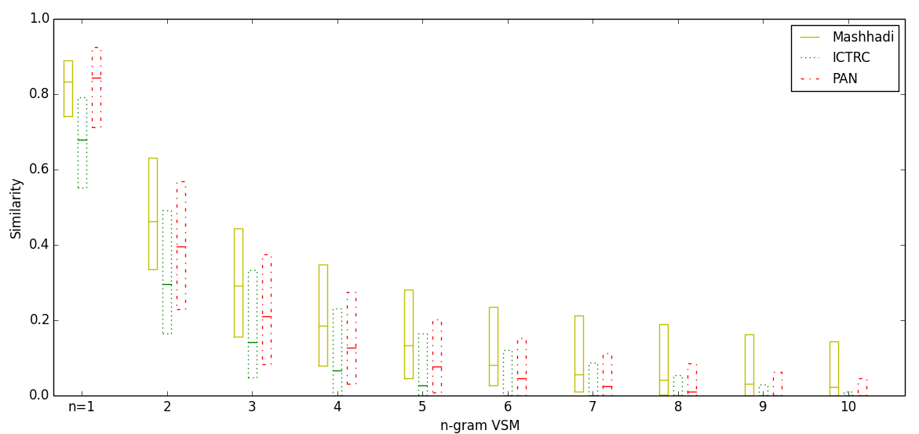
Results of Subtask #2
Corpus validation
Comparison of Simulated part of Mashhadi and ICTRC corpora
With PAN Corpus
34

Slide 35
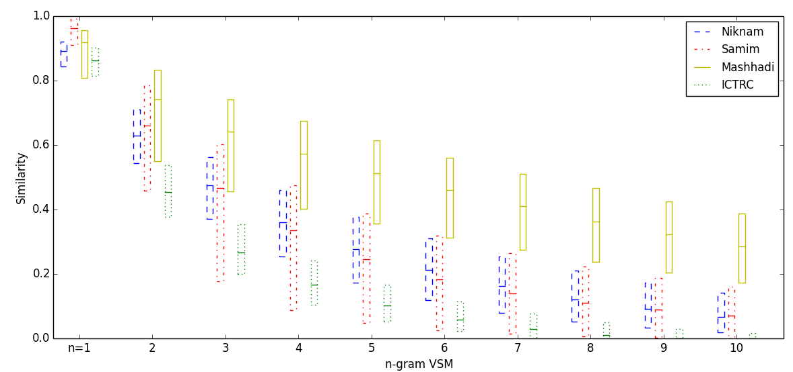
Results of Subtask #2
Corpus validation
Comparison of Artificial part of Niknam, Samim, Mashhadi and ICTRC corpora
With each other
35

Slide 36
Corpora Evaluation
PlagDet performance of some submitted approaches on the submitted corpora
The objective is how difficult it is to detect plagiarism within these corpora.
Team | Niknam | Samim | Mashhadirajab | ICTRC | Abnar
Gharavi | 0.8657 | 0.7386 | 0.5784 | 0.9253 | 0.3927
Momtaz | 0.8161 | - | - | 0.8924 | -
Minaei | 0.9042 | 0.6585 | 0.3877 | 0.8633 | 0.7218
Esteki | 0.5758 | - | - | - | 0.3830
Ehsan | 0.7196 | 0.5367 | 0.4014 | 0.7104 | 0.5890
Mansourizadeh | 0.2984 | - | 0.1286 | - | 0.2687
36

Slide 37
Note book papers
Ehsan, N, Shakery, A. A Pairwise Document Analysis Approach for Monolingual Plagiarism Detection
Esteki, F, Safi Esfahani, F. A Plagiarism Detection Approach Based on SVM for Persian Texts,
Gharavi, E, Bijari, k, Zahirnia, K, Veisi, H. A Deep Learning Approach to Persian Plagiarism Detection,
Gillam, L., and Vartapetiance, A., From English to Persian: Conversion of Text Alignment for Plagiarism Detection,
Mansoorizadeh, M, Rahgooy, T. Persian Plagiarism Detection Using Sentence Correlations,
Mashhadirajab, F, Shamsfard, M. A Text Alignment Algorithm Based on Prediction of Obfuscation Types Using SVM Neural Network,
Mashhadirajab, F, Shamsfard, M, Adelkhah, R, Shafiee, F., Saedi, S. A Text Alignment Corpus for Persian Plagiarism Detection,
Minaei, B, Niknam, M. An n-gram based Method for Nearly Copy Detection in Plagiarism Systems,
Momtaz, M, Bijari, K, Salehi, M, Veisi, H. Graph-based Approach to Text Alignment for Plagiarism Detection in Persian Documents,
Rezaei Sharifabadi, M., Eftekhari, S. A. Mahak Samim: A Corpus of Persian Academic Texts for Evaluating Plagiarism Detection Systems,
Talebpour, A, Shirzadi, M, Aminolroaya, Z. Plagiarism Detection based on a Novel Trie-based Approach

Slide 38
Thank you for your Attention

