Slide 1
Overview of Shared Task on Mixed Script Information Retrieval
Somnath Banerjee, Kunal Chakma, Sudip Kumar Naskar, Amitava Das, Paolo Rosso, Sivaji Bandyopadhyay, Monojit Choudhury

Slide 2
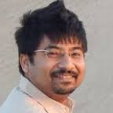
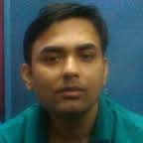
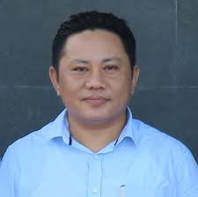
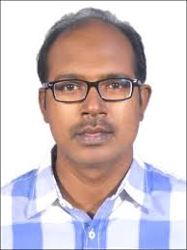
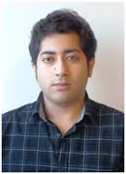
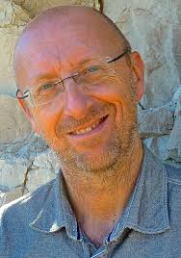
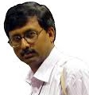
Coordinator
Monojit Choudhury
(Microsoft Research)
Subtask-1 Organizers
Subtask-2 Organizers
Somanth Banerjee (Jadavpur University)
Kunal Chakma
(NIT Agartala)
Sudip Kr Naskar
(Jadavpur University)
Amitava Das
(IIIT Sri City)
Paolo Rosso
(Technical University of Valencia)
Sivaji Bandyopadhyay
(Jadavpur University)

Slide 3
MSIR-2016: Outline
Subtask-1
Task
Dataset
Runs and Systems
Results
Observations
Subtask-2
Task
Dataset
Runs and Systems
Results
Observations
Conclusion

Slide 4
Subtask-1:
Task: Code-Mixed Cross-Script Question Classification
Example:
Q: “last volvo bus kokhon chare?”
English gloss: “When does the last volvo bus depart?” Class: Temporal Language: Bengali-English
Script: Roman

Slide 5
Subtask-1: Task
Let, Q = {q₁, q₂, …, q_{n}} be a set of factoid questions of type code-mixed cross-script
Question class C = {c_{1,} c_{2,}… , c_{m}}
Classify each given question q_{i} Q into one of the predefined classes c_{j} s C

Slide 6
Subtask-1: Question Taxonomy
Name | Description | Example
Person (PER) | Persons name | Ke Hazarduari toiri kore?
Location (LOC) | Locations | Airport theke textit kothai jabar bus nei?
Organization (ORG) | Organizations | Prepaid taxi counter naam ki?
Quantity (QUAN) | Numerical e.g., statistical related questions | Hazarduari te koto dorja ache?
Temporal (TEMP) | Temporal | Volvo bus howrah station jete koto time nei?
Monitory (MONY) | money related questions | Airport theke Howrah Station volvo bus fare koto?
Distance (DIST) | measurable distance related questions | Airport theke howrah station distance koto?
Object (OBJ) | Object e.g. temples, cannon objects etc. | Murshidabad kon nodir tire obosthito?
Miscellaneous (MISC) | Questions which not fall in other classes | Early morning journey hole kon service valo?

Slide 7
Subtask1: Participation
Initial show of interest from 15 teams
7 teams participated, 20 runs submitted
India: Amrita University, BITS Pilani, IIT Kharagpur, NIT Mizoram, ISM Dhanbad, Sapient

Slide 8
Subtask-1: Dataset
Total 510 code-mixed cross-script questions
Train/Dev set:
330 code-mixed cross-script questions
Total words: 1776
Avg. words/question: 5.321
Test set:
180 code-mixed cross-script questions
Total words: 1138
Avg. words/question: 6.322
Contributors:
Somanth Banerjee (JU)
Sudip Kr. Naskar (JU)
Paolo Rosso (UPV)
Sivaji Bandyopadhyay (JU)

Slide 9
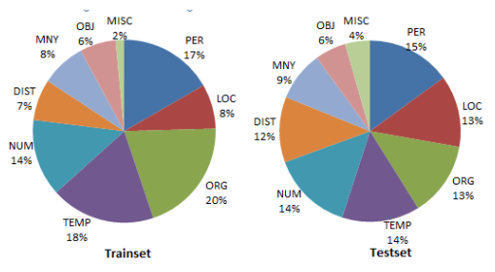
Subtask-1: Dataset
Class | Training | Testing
Person (PER) | 55 | 27
Location (LOC) | 26 | 23
Organization (ORG) | 67 | 24
Temporal (TEMP) | 61 | 25
Numerical (NUM) | 45 | 26
Distance (DIST) | 24 | 21
Money (MNY) | 26 | 16
Object (OBJ) | 21 | 10
Miscellaneous (MISC) | 5 | 8

Slide 10
Subtask-1: Systems
Team | Runs | System
AMRITA CEN | 2 | Used Bag-of-Words (BoW) model for the Run-1. The Run-2 was based on Recurrent Neural Network (RNN). BoW model outperformed RNN.
AMRITA-CEN-NLP | 3 | Used vector space model (VSM)
ANUJ | 3 | Support Vector Machines (SVM), Logistic Regression (LR), Random Forest (RF) and Gradient Boosting. RF performed the best.
BITS PILANI | 3 | Convert entire data into English using Google Translator API. Applied Naive Bayes (NB), LR and RF Classifier. NB performed the best
IINTU | 3 | Classifier combination approach using RF, One-vs-Rest and k-NN
NLP-NITMZ | 3 | Rule based system (39 rules). NB as machine learning approach
IIT(ISM)D | 3 | Used NB and Decision Tree
Total | 20

Slide 11
Subtask1: Metrics
Overall performance:
Class-based performance:

Slide 12
Subtask1: Results
Sl. No | Team | Total submission | Best-Run ID | Highest-Accuracy
1 | AmritaCEN | 2 | 1 | 80.556
2 | AMRITA-CEN-NLP | 3 | 1 | 79.444
3 | Anuj | 3 | 2 | 81.111
4 | BITS_PILANI | 3 | 1 | 81.111
5 | IINTU | 3 | 2 | 83.333
6 | NLP-NITMZ | 3 | 3 | 78.889
7 | IIT(ISM)D | 3 | 3 | 80.000
Subatsk-1 winner: IINTU

Slide 13
Subtask1: Results

Slide 14
Subtask-1: Observations
Most of the teams used machine learning based classifiers
Only NIT Mizoram used rule-based system
Classifier combination approach performed the best

Slide 15
MSIR-2016: Outline
Subtask-1
Task
Dataset
Runs and Systems
Results
Observations
Subtask-2
Task
Dataset
Runs and Systems
Results
Observations
Conclusion

Slide 16
Subtask-2
Task: Retrieve a ranked list of the top k (k=20) code-mixed Hindi-English Tweets for a given query containing Hindi and English search terms
Example queries: delhi mey eclection (election in Delhi), kejriwal is mukhya mantri (Kejriwal is Chief Minister)

Slide 17
Subtask-2
Teams registered: 10
Teams submitted runs: 7
Total runs submitted: 13

Slide 18
Subtask-2 datasets
Training Data
Corpus of Code-Mixed Hindi-English Tweets : 6133
Roman Transliterated Hindi-English Code-Mixed Queries : 23
Topics : 10
Average Length of Queries: 3.43 words
Test Data
Corpus of Code-Mixed Hind-English Tweets: 2769
Roman Transliterated Hindi-English Code-Mixed Queries: 12
Topics: 3
Average Length of Queries: 3.25 words
Contributors:
Kunal Chakma (NIT Agartala),
Amitava Das (IIIT Sri City)

Slide 19
Subtask-2 Runs and submissions
Team | Runs | System
UB | 3 | Named Entity based document boosting, query expansion and Narrative based weighting for the 3 runs respectively
Anuj | 2 | Work description not available
Amrita_CEN | 1 | Applied Distributional semantic representation followed by Cosine Similarity between query and documents
NLP-NITMZ | 1 | Work description not available
NITA_NITMZ | 1 | Performed stop word removal followed by query segmentation and finally merging the results obtained from the different combination of the words of the query text
CEN@Amrita | 2 | Vector Space Model based solution
IIT(ISM)D | 3 | Query terms were expanded using Soundex coding scheme
Total | 13

Slide 20
Subtask-2 results
Team | Best Run ID | MAP
Amrita_CEN | 1 | 0.0377
CEN@Amrita | 1 | 0.0315
UB | 1 | 0.0217
Anuj | 1 | 0.0209
NLP-NITMZ | 1 | 0.0203
NITA_NITMZ | 1 | 0.0047
IIT(ISM)D | 2 | 0.0083
Subatsk-2 winner: Amrita_CEN

Slide 21
Subtask-2 observations
The best system (Amrita_CEN) achieved a MAP of only 0.0377.
The above scores suggest that Information Retrieval from Code-Mixed bi-lingual micro blog texts such as tweets is a difficult task.
Better techniques are required for improving the results.

Slide 22
ConclusionS
Encouraging participation
MSIR-2015: 10 teams 24 runs
MSIR-2016: 9 teams 33 runs
Larger dataset for subtask-1
New language pairs

Slide 23
Looking forward to increased participation in FIRE 2017!!

