Slide 1
Populating and Evaluating Knowledge Bases
Hoa Dang
NIST
December 8, 2016

Slide 2
NIST Family of Community Evaluations
Text Retrieval Conference (TREC): IR; search, filtering, distillation.
TREC Video Retrieval Evaluation (TRECVID): segmentation, indexing, and content-based retrieval of digital video
Text Analysis Conference (TAC): NLP; extraction, summarization, semantic entailment.
Low Resource Human Language Technology (LoReHLT): MT, extraction in Low Resource Languages for Emergent Incidents (earthquakes, etc.)

Slide 3
TAC Goals
To promote research in NLP based on large common test collections
To improve evaluation methodologies and measures for NLP
To build test collections that evolve to meet the evaluation needs of state-of-the-art NLP systems
To increase communication among industry, academia, and government by creating an open forum for the exchange of research ideas
To speed transfer of technology from research labs into commercial products

Slide 4
Features of TAC
Component evaluations situated within context of end-user tasks (e.g., summarization, knowledge base population)
opportunity to test components in end-user tasks
Test common techniques across tracks
“Small” number of tracks
critical mass of participants per track
sufficient resources per track (data, annotation/assessing, technical support)
Leverage shared resources across tracks (organizational infrastructure, data, annotation/assessing, tools)
Notes:
These features of TAC are best illustrated in our evaluations for Knowledge Base Population

Slide 5
TAC KBP (2009 – present)
Sponsored by US Department of Defense
Goal: Populate a knowledge base (KB) with information about real world entities as found in a collection of source documents
KB must be suitable for automatic downstream analytic tools; no human in the loop (contrast to KB as a visualization or browsing tool)
Input is unstructured text, output is structured KB
Follow a predefined schema for the KB (rather than OpenIE)
Confidence associated with each assertion whenever possible, to guide usage in downstream analytics
Two use cases:
Augment an existing reference KB
Construct a KB from scratch (Cold Start KBP)
Notes:
Use cases defining parameters of the task and evaluation
Early years focused on augment existing KB; recent years shifted to building a KB from scratch. In principle, the former task requirements are subsumed by the latter.

Slide 6
Knowledge Graph Representation of KB
Springfield
Seymore Skinner
per:cities_of_residence
Margaret Simpson
Entity
Contact.Meet
Location
Bottomless Pete, Nature’s
Cruelest Mistake
Entity
per:cities_of_residence
per:alternate_names
Marge Simpson
Homer Simpson
per:spouse
Springfield Elementary
per:children
per:children
Noncommited
Belief
Lisa Simpson
Negative
Sentiment
Bart Simpson
per:schools_attended

Slide 7
Difficult to evaluate KBP as a single task
Wide range of capabilities required to construct a KB
KB construction is a complex task, but open community tasks are usually small (suitable even for a single researcher)
Barrier to entry even greater when require multi-lingual processing and cross-lingual fusion
KB is a complex structure → single-point estimator for KB quality provides little diagnostics for failure analysis

Slide 8
TAC approach to KBP evaluation
Decompose the KB construction task into smaller components
Entities
Relations (“slot filling”)
Events
Sentiment
Belief
Allow participation in single component tasks, and evaluate each component separately
Incrementally increase difficulty of tasks, building infrastructure along the way; provide component-specific evaluation resources to allow component capabilities to mature and develop in their own way
As technology matures, incorporate components into a real KB and evaluate as part of the KB

Slide 9
2009 KBP Setup
Knowledge Base (KB)
Entities and attributes (a.k.a., “slots”) derived from Wikipedia home pages and infoboxes are used to create the reference KB
Source Collection
A large corpus of newswire, web documents is provided for systems to discover information to expand and populate KB
Two component tasks
Entities (Entity Linking)
Relations (Slot Filling)

Slide 10
Entities

Slide 11
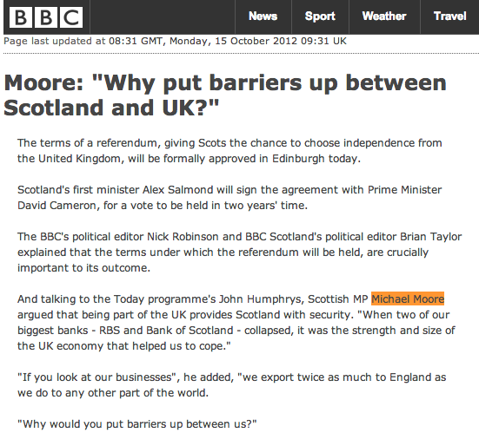
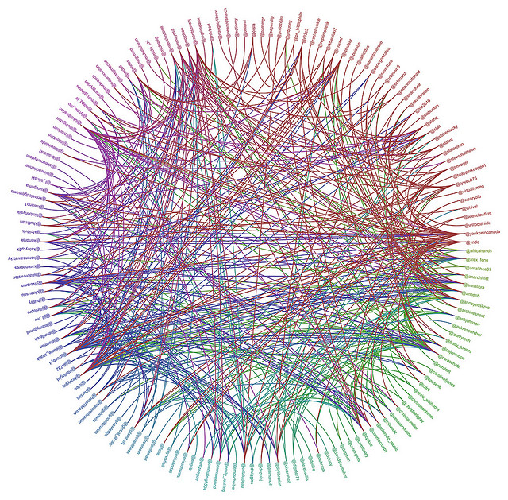
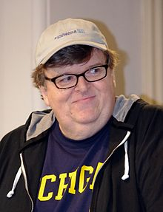
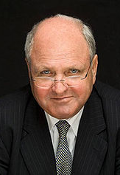
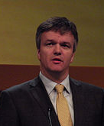
2009 English Entity Linking
English source document
Query
And talking to the Today programme's John Humphrys, Scottish MP Michael Moore argued that being part of the UK provides Scotland with security. "When two of our biggest banks - RBS and Bank of Scotland - collapsed, it was the strength and size of the UK economy that helped us to cope."
Query name offsets
Entity Linking System
English Knowledge base

Slide 12
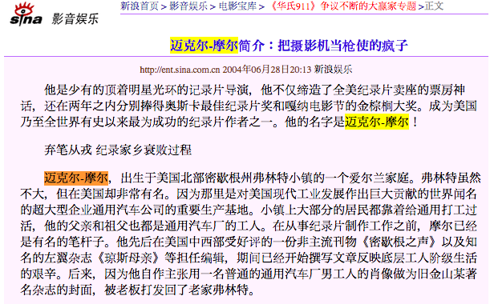
2011 Cross-Lingual Entity Linking
Chinese source document
Query
他是少有的顶着明星光环的记录片导演，他不仅缔造了全美纪录片卖座的票房神话，还在两年之内分别捧得奥斯卡最佳纪录片奖和嘎纳电影节的金棕榈大奖。成为美国乃至全世界有史以来最为成功的纪录片作者之一。他的名字是迈克尔-摩尔！
Entity Linking System
English Knowledge base

Slide 13
2012 Cross-Lingual Entity Linking
Spanish source document
Query
El preacuerdo, alcanzado tras varios meses de negociaciones entre el ministro británico para Escocia, Michael Moore, y la número dos del Gobierno escocés, Nicola Sturgeon, fue cerrado el lunes por la noche en una conversación telefónica entre ambos, que se reunirán para el visto bueno final el viernes que viene
Entity Linking System
English Knowledge base

Slide 14
2014 English EDL Task
EDL System
English Knowledge base

Slide 15
2015 Cross-Lingual EDL Task
EDL System
English Knowledge base

Slide 16
The 2016 Cross-Lingual EDL Task
Input
A large set of raw documents in English, Chinese and Spanish
Genres include newswire, discussion forum
Output
Document ID, offsets for mentions (including nested mentions)
Entity type: GPE, ORG, PER, LOC, FAC
Mention type: name, nominal
Reference KB link entity ID, or NIL cluster ID
Confidence value
EDL produces KB entity nodes from raw text, including all named and nominal mentions of each entity

Slide 17
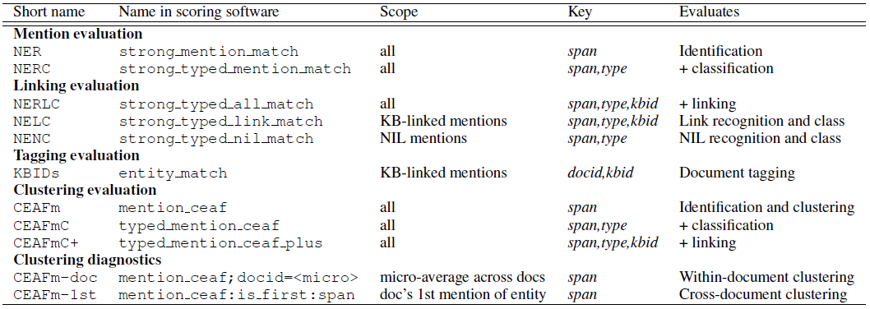
Evaluation Measures
New Diagnostic Metrics
CEAFm-doc: within-document coreference performance, micro-averaging across all documents
CEAFm-1st: approximate cross-document performance by limiting evaluation to the first mention per document of each entity
Confidence intervals: bootstrap resampling documents from the corpus, calculating these pseudo-systems scores, and determining their values at the (100-c)/2 th and (100+c)/2 th percentiles of 2500 bootstrap resamples

Slide 18
Relations

Slide 19
KBP generic slots derived from Wikipedia infobox
Person |  | Organization
per:alternate_names |  | org:alternate_names
per:date_of_birth | per:employee_or_member_of | org:political_religious_affiliation
per:age | per:religion | org:top_members_employees
per:country_of_birth | per:spouse | org:number_of_employees
per:stateorprovince_of_birth | per:children | org:members
per:city_of_birth | per:parents | org:member_of
per:date_of_death | per:siblings | org:subsidiaries
per:country_of_death | per:other_family | org:parents
per:stateorprovince_of_death | per:charges | org:founded_by
per:city_of_death |  | org:date_founded
per:cause_of_death |  | org:date_dissolved
per:countries_of_residence |  | org:country_of_headquarters
per:statesorprovinces_of_residence |  | org:stateorprovince_of_headquarters
per:cities_of_residence |  | org:city_of_headquarters
per:schools_attended |  | org:shareholders
per:title |  | org:website
Notes:
Slots by entity type
Single-valued vs list-valued

Slide 20
Slot-Filling Task Requirements
Task: given a query entity and predefined slots for each entity type (PER, ORG), return all new slot fillers for that entity that can be found in the source documents, and provenance justifying that the filler is correct
Non-redundant
Don’t return more than one instance of a slot filler (requires weak NER coref)
Exact boundaries of filler string, as found in supporting document
Text is complete (e.g., “John Doe” rather than “John”)
No extraneous text (e.g., “John Doe” rather than “John Doe’s house”)
Evaluation based on TREC-QA pooling methodology, combine
Candidate slot fillers from non-exhaustive manual search
Candidate slot fillers from fully automatic systems

Slide 21
Slot-Filling Evaluation
Pool responses from submitted runs and from manual search
Set of [answer-string, provenance] pairs for each target entity and slot
Assessment:
Each pair judged as one of correct, redundant, inexact, or wrong (credit given only for redundant and correct responses)
Correct pairs grouped into equivalence classes (entities); each single-valued slot has at most one equivalence class for a given target entity
Scoring:
Recall: number of correct equivalence classes returned / number of known equivalence classes
Precision: number of correct equivalence classes returned / number of [docid, answer-string] pairs returned
F1 = (P*R)/(R+P)

Slide 22
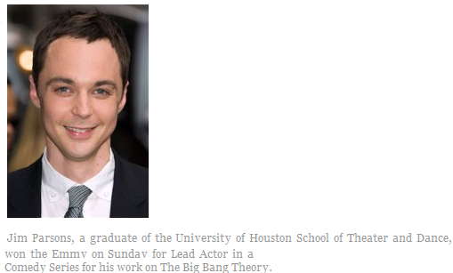
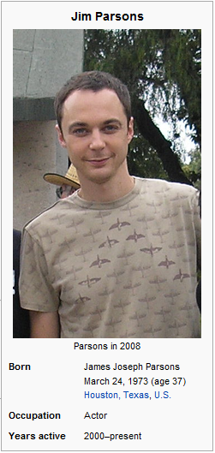
Slot Filling: Create Wiki Infoboxes
<query id="SF114">
<name>Jim Parsons</name>
<docid>eng-WL-11-174592-12943233</docid>
<enttype>PER</enttype>
<nodeid>E0300113</nodeid>
<ignore>per:date_of_birth
per:age per:country_of_birth
per:city_of_birth</ignore>
</query>
School Attended: University of Houston
Notes:
Initially, query entities were unambiguous, focus on finding attributes associated with the name.
Then added more ambiguous query entities (Is this child a child of “George W. Bush” (the target entity), or “George H.W. Bush”?)
Then removed nodeid from query – “Which George Bush should we find attributes for?” Must use context of entity mention in query to disambiguate the entity mention
Remove reference KB altogether – just extract all slot fillers for the query entity defined by the entity mention in the query.

Slide 23
Slot Filling: Create Wiki Infoboxes
<query id="SF114">
<name>Jim Parsons</name>
<docid>eng-WL-11-174592-12943233</docid>
<enttype>PER</enttype>
<nodeid>E0300113</nodeid>
<ignore>per:date_of_birth
per:age per:country_of_birth
per:city_of_birth</ignore>
</query>

Slide 24
Slot Filling: Create Wiki Infoboxes
<query id="SF114">
<name>Jim Parsons</name>
<docid>eng-WL-11-174592-12943233</docid>
<enttype>PER</enttype>
<nodeid>E0300113</nodeid>
<ignore>per:date_of_birth
per:age per:country_of_birth
per:city_of_birth</ignore>
</query>

Slide 25
Cold Start KB

Slide 26
2012-2016 Cold Start KBP
Schema
per:children
per:other_family
per:parents
per:siblings
per:spouse
per:employee_or_member_of
per:schools_attended
per:city_of_birth
per:stateorprovince_of_birth
per:country_of_birth
per:cities_of_residence
per:statesorprovinces_of_residence
per:countries_of_residence
per:city_of_death
per:stateorprovince_of_death
per:country_of_death
org:shareholders
org:founded_by

Slide 27
Cold Start Task
You are given:
Schema
per:children
per:other_family
per:parents
per:siblings
per:spouse
per:employee_of
per:member_of
per:schools_attended
per:city_of_birth
per:stateorprovince_of_birth
per:country_of_birth
per:cities_of_residence
per:statesorprovinces_of_residence
per:countries_of_residence
per:city_of_death
per:stateorprovince_of_death
per:country_of_death
org:shareholders
org:founded_by
When Lisa's mother Marge Simpson went to a weekend getaway at Rancho Relaxo, the movie The Happy Little Elves Meet Fuzzy Snuggleduck was one of the R-rated european adult movies available on their cable channels.
When Lisa's mother Marge Simpson went to a weekend getaway at Rancho Relaxo, the movie The Happy Little Elves Meet Fuzzy Snuggleduck was one of the R-rated european adult movies available on their cable channels.
When Lisa's mother Marge Simpson went to a weekend getaway at Rancho Relaxo, the movie The Happy Little Elves Meet Fuzzy Snuggleduck was one of the R-rated european adult movies available on their cable channels.
When Lisa's mother Marge Simpson went to a weekend getaway at Rancho Relaxo, the movie The Happy Little Elves Meet Fuzzy Snuggleduck was one of the R-rated european adult movies available on their cable channels.
When Lisa's mother Marge Simpson went to a weekend getaway at Rancho Relaxo, the movie The Happy Little Elves Meet Fuzzy Snuggleduck was one of the R-rated european adult movies available on their cable channels.
When Lisa's mother Marge Simpson went to a weekend getaway at Rancho Relaxo, the movie The Happy Little Elves Meet Fuzzy Snuggleduck was one of the R-rated european adult movies available on their cable channels.
When Lisa's mother Marge Simpson went to a weekend getaway at Rancho Relaxo, the movie The Happy Little Elves Meet Fuzzy Snuggleduck was one of the R-rated european adult movies available on their cable channels.
When Lisa's mother Marge Simpson went to a weekend getaway at Rancho Relaxo, the movie The Happy Little Elves Meet Fuzzy Snuggleduck was one of the R-rated european adult movies available on their cable channels.
When Lisa's mother Marge Simpson went to a weekend getaway at Rancho Relaxo, the movie The Happy Little Elves Meet Fuzzy Snuggleduck was one of the R-rated european adult movies available on their cable channels.

Slide 28
When Lisa's mother Marge Simpson went to a weekend getaway at Rancho Relaxo, the movie The Happy Little Elves Meet Fuzzy Snuggleduck was one of the R-rated european adult movies available on their cable channels.
Schema
per:children
per:other_family
per:parents
per:siblings
per:spouse
per:employee_of
per:member_of
per:schools_attended
per:city_of_birth
per:stateorprovince_of_birth
per:country_of_birth
per:cities_of_residence
per:statesorprovinces_of_residence
per:countries_of_residence
per:city_of_death
per:stateorprovince_of_death
per:country_of_death
org:shareholders
org:founded_by
When Lisa's mother Marge Simpson went to a weekend getaway at Rancho Relaxo, the movie The Happy Little Elves Meet Fuzzy Snuggleduck was one of the R-rated european adult movies available on their cable channels.
When Lisa's mother Marge Simpson went to a weekend getaway at Rancho Relaxo, the movie The Happy Little Elves Meet Fuzzy Snuggleduck was one of the R-rated european adult movies available on their cable channels.
When Lisa's mother Marge Simpson went to a weekend getaway at Rancho Relaxo, the movie The Happy Little Elves Meet Fuzzy Snuggleduck was one of the R-rated european adult movies available on their cable channels.
When Lisa's mother Marge Simpson went to a weekend getaway at Rancho Relaxo, the movie The Happy Little Elves Meet Fuzzy Snuggleduck was one of the R-rated european adult movies available on their cable channels.
You Must Produce:
When Lisa's mother Marge Simpson went to a weekend getaway at Rancho Relaxo, the movie The Happy Little Elves Meet Fuzzy Snuggleduck was one of the R-rated european adult movies available on their cable channels.
When Lisa's mother Marge Simpson went to a weekend getaway at Rancho Relaxo, the movie The Happy Little Elves Meet Fuzzy Snuggleduck was one of the R-rated european adult movies available on their cable channels.
When Lisa's mother Marge Simpson went to a weekend getaway at Rancho Relaxo, the movie The Happy Little Elves Meet Fuzzy Snuggleduck was one of the R-rated european adult movies available on their cable channels.
When Lisa's mother Marge Simpson went to a weekend getaway at Rancho Relaxo, the movie The Happy Little Elves Meet Fuzzy Snuggleduck was one of the R-rated european adult movies available on their cable channels.
Springfield
Bottomless Pete, Nature’s
Cruelest Mistake
per:cities_of_residence
per:alternate_names
Marge Simpson
Homer Simpson
per:spouse
Springfield Elementary
per:children
per:children
per:schools_attended
Lisa Simpson
Bart Simpson

Slide 29
Cold Start Evaluation
Where did the children of
Marge Simpson go to school?
Springfield
per:children
per:schools_attended
Bottomless Pete, Nature’s
Cruelest Mistake
per:cities_of_residence
per:alternate_names
Marge Simpson
Homer Simpson
per:spouse
Springfield Elementary
per:children
per:children
per:schools_attended
Lisa Simpson
Bart Simpson

Slide 30
After two years in the academic quagmire of Springfield Elementary, Lisa finally has a teacher that she connects with. But she soon learns that the problem with being middle-class is that
When Lisa's mother Marge Simpson went to a weekend getaway at Rancho Relaxo, the movie The Happy Little Elves Meet Fuzzy Snuggleduck was one of the R-rated european adult movies available on their cable channels.
Springfield
Bottomless Pete, Nature’s
Cruelest Mistake
per:cities_of_residence
per:alternate_names
Marge Simpson
Homer Simpson
Springfield Elementary
per:children
per:children
per:spouse
per:schools_attended
Lisa Simpson
Bart Simpson

Slide 31
2012-2016 Cold Start KB Construction Task
Goal: Build a KB from scratch, containing all attributes about all entities as found in a corpus
ED(L) system component identifies KB entities and all their NAM/NOM mentions
Slot Filling system component identifies entity attributes (fills in “slots” for the entity)
Inventory of 41+ slots for PER, ORG, GPE
Filler must be an entity (PER, ORG, GPE), value/date, or (rarely) a string (per:cause_of_death)
Filler entity must be represented by a name or nominal mention
Post-submission slot filling evaluation queries traverse KB starting from a single entity mention (entry point into the KB):
Hop-0: “Find all children of Marge Simpson”
Hop-1: “Find schools attened by each child of Marge Simpson”

Slide 32
Cold Start KB/SF/EDL Task Variants and Evaluation
Task Variants:
Full KB Construction (CS-KB): Ground all named or nominal entity mentions in docs to newly constructed KB nodes (ED, clustering); extract all attested attributes about all entities
SF (CS-SF): Given a query, extract specified attributes (fill in specified slots) for the query entities.
Slot Filling Evaluation (primary for CS-KB):
P/R/F1 over slot fillers, as in standalone SF task evaluation
Report P/R/F1 over fillers for hop0, for hop1, and for all hop1 and hop1
Entity Discovery Evaluation:
Same as for standalone EDL task

Slide 33
Cold Start SF Scorer
Multiple options for metrics and policies, depending on use
Lenient matching to score KBs not in official evaluation (and therefore not assessed by LDC)
Macro-average and micro-average P/R/F1
Official metric
requires exact match to assessed fillers
penalizes redundant slot fillers (failure to identify that two fillers are the same entity or value)
automatically penalizes hop1 responses whose hop0 parent is incorrect

Slide 34
EDL + SF = Cold Start KB ?
EDL/SF systems may need to pursue different optimization strategies when embedded in a KB vs in standalone tasks
Multi-hop evaluation queries for KB requires SF component to operate at higher precision along the Precision-Recall curve
Cascaded errors
”land mines” and high fan-out hop1 slots inflict huge penalty for a single mis-step (e.g., “Who are the residents of the country where Barack Obama was born?)
Best Cold Start KB split cross-document entities (outliers, then very large entities):
Improved slot filling precision at hop0 and hop1 level
Reduced standalone EDL scores (mention_ceaf and b-cubed)
EDL component may need to operate at a higher precision within a KB than in a standalone (generic) EDL task.

Slide 35
Events

Slide 36
Event Ontology
Event Label (Type.Subtype) | Role | Allowable ARG Entity/Filler Type
Movement.Transport-Artifact | Agent | PER, ORG, GPE
 | Artifact | WEA, VEH, FAC, COM
 | Destination | GPE, LOC, FAC
 | Instrument | VEH, WEA
 | Origin | GPE, LOC, FAC
Movement.Transport-Person | Agent | PER, ORG, GPE
Personnel.Elect | Agent | PER, ORG, GPE
 | Person | PER
 | Position | Title
Personnel.End-Position | Entity | ORG, GPE
 | Person | PER
 | Position | Title
Personnel.Start-Position | Entity | ORG, GPE
 | Person | PER
 | Position | Title
Transaction.Transaction | Beneficiary | PER, ORG, GPE
 | Giver | PER, ORG, GPE
 | Recipient | PER, ORG, GPE
Transaction.Transfer-Money | Beneficiary | PER, ORG, GPE
 | Giver | PER, ORG, GPE
 | Money | MONEY
 | Recipient | PER, ORG, GPE
Transaction.Transfer-Ownership | Beneficiary | PER, ORG, GPE
 | Giver | PER, ORG, GPE
 | Recipient | PER, ORG, GPE
 | Thing | VEH, WEA, FAC, ORG,COM
Event Label (Type.Subtype) | Role | Allowable ARG Entity/Filler Type
Conflict.Attack | Attacker | PER, ORG, GPE
 | Instrument | WEA, VEH, COM
 | Target | PER, GPE, ORG, VEH, FAC, WEA, COM
Conflict.Demonstrate | Entity | PER, ORG
Contact.Broadcast | Audience | PER, ORG, GPE
 | Entity | PER, ORG, GPE
Contact.Contact | Entity | PER, ORG, GPE
Contact.Correspondence | Entity | PER, ORG, GPE
Contact.Meet | Entity | PER, ORG, GPE
Justice.Arrest-Jail | Agent | PER, ORG, GPE
 | CRIME | CRIME
 | Person | PER
Life.Die | Agent | PER, ORG, GPE
 | Instrument | WEA, VEH, COM
 | Victim | PER
Life.Injure | Agent | PER, ORG, GPE
 | Instrument | WEA, VEH, COM
 | Victim | PER
Manufacture.Artifact | Agent | PER, ORG, GPE
 | Artifact | VEH, WEA, FAC, COM
 | Instrument | WEA, VEH, COM

Slide 37
Event Argument Extraction and Linking
Goal: Extract event & role/argument assertions to insert into KB
Three cascaded, cumulative tasks introduced 2014-2016:
2014: Event Argument Extraction
2015: Event Argument Extraction and (within-doc) Linking
2016: Event Argument Extract and (within-doc and cross-doc) Linking

Slide 38
2014 Event Argument Extraction (EA)
Task:
Identify entities that participate in an event and their role; each assertion is labeled with:
event type
role
canonical string for the argument (similar to Cold Start slot filling)
realis (ACTUAL, GENERIC, OTHER)
justification
Metric:
Accuracy of argument extraction (F1 and Arg Accuracy score)
Answers are correct when all components (event type, role, justification, realis, and canonical string for argument are correct)
Assessment-based evaluation (pool includes a manual run)

Slide 39
2015 Event Argument Extraction and Linking
Task:
Identify entities that participate in an event and their role
Within a document, group those participants of the same event into event frames
Metric:
Document linking (B^3)
Measure over only correct arguments

Slide 40
2016 Event Argument Extraction and Linking
Task:
Identify entities that participate in an event and their role
Within a document, group those participants of the same event into event frames
Group coreferent event frames across the corpus
Metric:
Cross document linking (query based)

Slide 41
Status of Events in KBP
Low recall on event argument extraction (EA) task remains a bottleneck for EAL after 3 years of event evaluations.
We’ve still got a long way to go for Events
In 2016, switched to gold standard based evaluation of within-doc EA and EAL tasks
Supports evaluation of systems even after the official NIST evaluation.
Gold standard annotations revealed incompleteness of previous assessment pools (even when a time-limited manual run was included in the pool)

Slide 42
Belief and Sentiment

Slide 43
2016 Belief and Sentiment (BeSt)
Detect belief (Committed, Non-Committed, Reported) and sentiment (positive, negative), including source entities and targets
Sources are Entities (person, organization, geopolitical entity)
Targets can be:
Entities: for sentiment (”Mary likes John”)
Relations: for belief (“John believes Mary was born in Kenya”) and sentiment (“John doesn’t like that Mary is president”)
Events: for belief (“John thought there might have been demonstrations supporting his election”) and sentiment (“John loved the demonstrations”)
Possible source entities and targets are given as input, BeSt system focuses on detecting belief/sentiment between them.

Slide 44
BeSt 2016
Input:
Source Documents: 500 “core” documents
ERE (Entity, Relation, Event) annotations of the core documents
Gold standard ERE
Predicted ERE (from a volunteer KBP team)
Output
Belief (Committed, Non Committed, Reported) and/or Sentiment (positive, negative) tags from Entities to targets that are other Entities, Relations, or Events, as given in the ERE annotations; provenance is set of mentions of the targets, given in the ERE annotations,
Evaluation against gold standard belief and sentiment annotation of core docs
First year of BeSt
Scores under the Predicted ERE condition very low, partly due to overly strict matching criteria in the scorer
Provides training/development resources for future evals

Slide 45
TAC KBP 2016
 | Languages | Cross-Lingual | Docs Input | Docs evaluated, by gold standard annotation
EDL | ENG, CMN, SPA | Y | 90,000 / 3 | 500 / 3
Cold Start KB/SF | ENG, CMN, SPA | Y | 90,000 / 3 | (assessment)
Event Argument | ENG, CMN, SPA | Y | 90,000 / 3 | 500 / 3 (+assessment)
Event Nugget | ENG, CMN, SPA | N | 500 / 3 | 500 / 3
Belief and Sentiment | ENG, CMN, SPA | N | 500 / 3 | 500 / 3
Gold Standard annotations on the same “core” set of documents across all tasks.

Slide 46
What’s next?

Slide 47
Build a Cold Start++ KB
Springfield
Seymore Skinner
Entity
Contact.Meet
Location
Bottomless Pete, Nature’s
Cruelest Mistake
Entity
per:cities_of_residence
per:alternate_names
Marge Simpson
Homer Simpson
per:spouse
Springfield Elementary
per:children
per:children
Noncommited
Belief
Lisa Simpson
Negative
Sentiment
Bart Simpson
per:schools_attended

Slide 48
KBP 2017
Component KBP tasks and evaluations (as in 2016)
EDL
Slot Filling
Event Nuggets, Event Argument Extraction and Linking
Belief and Sentiment
Cold Start++ KB Construction task (Required of DEFT mega-teams)
Systems construct KB from raw text. KB contains:
Entities
Relations (Slots)
Events
Some aspects of Belief and Sentiment
KB populated from English, Chinese, and Spanish (30K/30K/30K docs)

Slide 49
KBP 2017
2017 may be last year when KBP evaluation is funded on a large scale, for so many component tasks
Use gold standard based evaluation whenever possible, to support continued component system development and evaluation after the official TAC KBP evaluations
for EDL, within-doc Event extraction and linking, belief, belief, and sentiment
Use query and assessment-based evaluation as needed for cross-document linking, evaluating the KB as a unified construct

Slide 50
MAP and multi-hop confidence values
Add Mean Average Precision (MAP) as a primary metric to consider confidence values in KB relation provenances
To compute MAP, rank all responses (single-hop and multi-hop) by confidence value
Hop0 response: confidence is same as confidence associated with that provenance
Hop1 response: confidence is product of confidence of each single-hop response along this path (from query to hop1)
Errors in hop1 get penalized less than errors in hop0
MAP could be a way to evaluate performance on hop0 and hop1 in a unified way that doesn’t overly penalize hop1 errors.

Slide 51
Conclusions and future directions
Complex KB Construction task effectively decomposed into component tasks for open community evaluations
Putting the components together requires additional tuning to optimize for composite (rather than component) evaluation
Trend towards gold standard based evaluation when possible, to support post-hoc component system development and evaluation
Trend towards confidence/ranking metrics like MAP when possible
Trend toward alternative hypotheses (related to belief state), including assertions with ACTUAL, as well as GENERIC, OTHER realis

Slide 52
Thanks to KBP track coordinators!
Paul McNamee (Johns Hopkins University HLTCOE)
Ralph Grishman (New York University)
Heng Ji (Renssalaer Polytechnic Institute)
Javier Artiles (Rakuten Technology)
Mihai Surdeanu (University of Arizona)
Jim Mayfield (Johns Hopkins University HLTCOE)
Marjorie Freedman (Raytheon BBN)
Teruko Mitamura (Carnegie Mellon University)
Ed Hovy (Carnegie Mellon University)
Claire Cardie (Cornell University)
Owen Rambow (Columbia University)
Linguistic Data Consortium (LDC)

Slide 53
LoReHLT – Low Resources HLT
Open evaluations of component technologies relevant to LORELEI (Low Resource Languages for Emergent Incidents)
LoReHLT16: NER, MT, and Situation Frames in Uyghur
LoReHLT17: EDL, MT and Situation Frames
Two surprise incident languages (IL’s) in parallel
Three evaluation checkpoints to gauge performance based on time and resources given
EDL in LoReHLT similar to but more challenging than EDL in KBP
2~3 weeks in August (after ACL)
https://www.nist.gov/itl/iad/mig/lorehlt-evaluations

