Slide 1
CSRS: A Context and Sequence Aware Recommendation System
Rajiv Srivastava, Swapnil Hingmire, Girish K. Palshikar, Saheb Chaurasia,
{rajiv.srivastava, swapnil.hingmire, gk.palshikar, saheb.c}@tcs.com
TCS Research
and
Arati Dixit
arati.dixit@unipune.ac.in
SP Pune University

Slide 2
Motivation
TCS is a learning organization with ~3,80,000 associates
  Technology landscape is evolving
  Each associate undertakes trainings to improve her competencies, proficiency levels, for career growth …
Trainings taken depend on multiple factors such as held skills, past trainings, project requirements, personal aspirations, etc.
TCS has multiple training delivery channels
  Information overload, multiple trainings on same subject available
  Training search is not personalized
Objective
  Need of personalized and proactive recommendations for training
  Help for project managers/leaders
  Increasing engagement through recommendation systems

Slide 3
Challenges
A user would like to be expert in a set of related skills (for example, a Java programmer would like to be good with JDBC for DB access)
Personalized recommendation requires use of user profile consisting of past trainings and context such as project skill requirement
Categorical, arbitrary and a large number of features
Sequence as well as context in single model
  Precision
  Explain-ability
  Overcoming cold-start

Slide 4
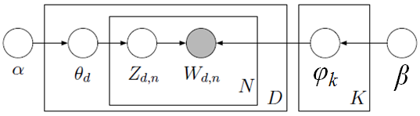
Latent Dirichlet Allocation (LDA)
Probabilistic generative model for discrete data such as documents
LDA assumes document is a mixture of topics and a topic is a probability distribution over vocabulary
To generate a new document d,
First the distribution over topics shown as θ_{d} should be specified.
For each word in the document a topic z_{d,n} is selected based on θ_{d}. According to φ_{z} a word is picked and is added to the document.
Blei et. al. JMLR 2003

Slide 5
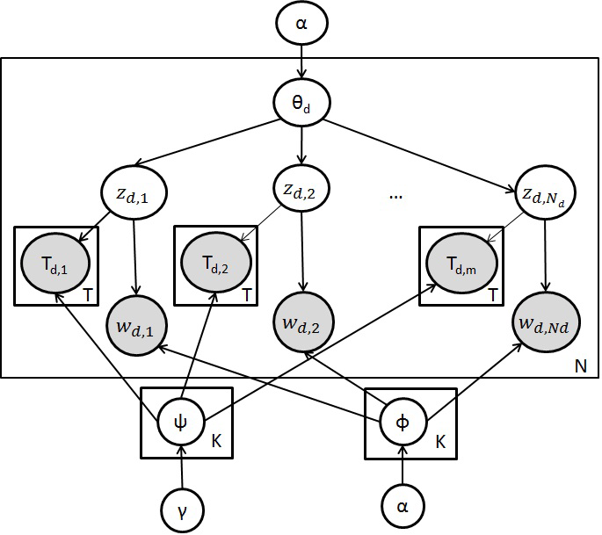
Context-aware Recommendation System
β
To generate a new document d,
First the distribution over topics shown as θ_{d} should be specified.
For each word in the document a topic i = z_{d,n} is selected based on θ_{d}. According to φ_{i} a word is picked and is added to the document.
According to ψ_{i} a keyword is picked and is added to the document.
Hariri et. al. RecSys 2013

Slide 6
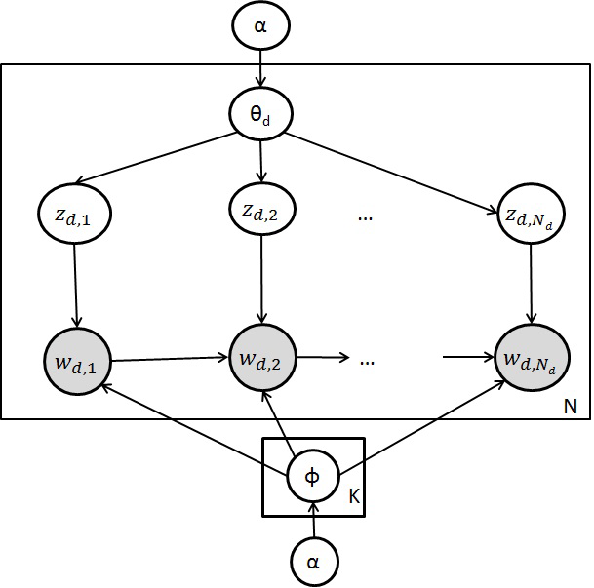
Sequence based Recommendation System
To generate a new document d,
First the distribution over topics shown as θ_{d} should be specified.
For each word in the document a topic i = z_{d,n} is selected based on θ_{d}. According to φ_{i} a bigram of size 2, is picked and is added to the document.
Barbieri et. al. JMLR 2013

Slide 7

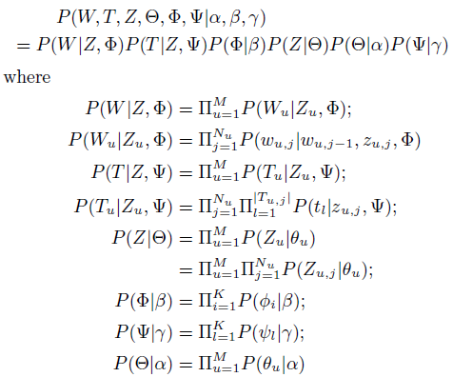
Context and Sequence aware Recommendation System (CSRS)
  Bigram based
β
To generate a new document d,
First the distribution over topics shown as θ_{d} should be specified.
For each word in the document a topic i = z_{d,n} is selected based on θ_{d}.
According to φ_{i} a bigram of size 2, is picked and is added to the document.
According to ψ_{i} a keyword is picked and is added to the document.

Slide 8
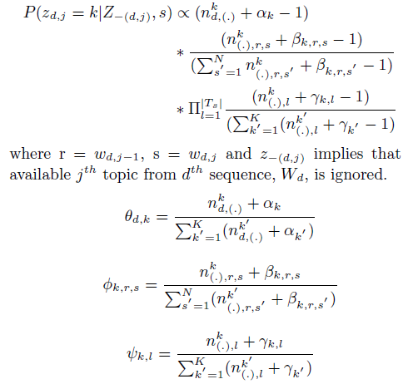
Collapsed Gibbs Sampling update for CSRS
Prob. of topic k given a word and prev. word
α (No. of words from k^{th} topic,
No. of bigrams from k^{th} topic,
No. of keywords from k^{th} topic)

Slide 9
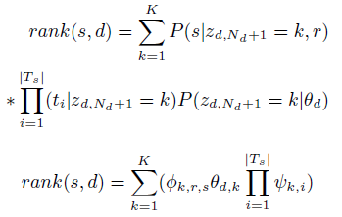
Ranking items using CSRS model
For a user d with a trace W_{d} consisting of N_{d} preferred items, the rank of an item s as recommendation for N_{d}+1 item selection is as follows:
Rank of an word given prev. word
α
sum over k (
Prob. of word s given topic k,
Prob. of bigram s->s’ given topic k,
Prob. of keywords with topic k)

Slide 10
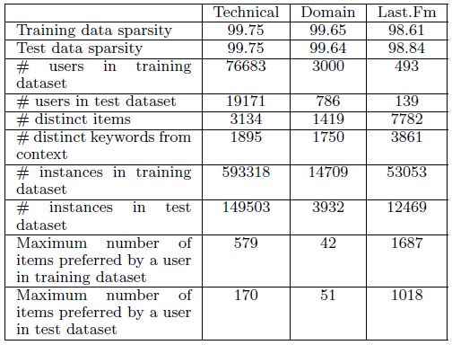
Dataset
Technical trainings pertain to technology platforms such as J2EE and .Net, technologies such as JSP and JSF, frameworks such as Struts and Hibernate, packaged software such as SAP, to name a few.
Domain trainings pertain to the business domains such as Banking, Insurance, Manufacturing, Retail, and so on.
last.fm standard dataset
Trainings data is for 5 years.
The last.fm data has listening history of users over 7 year duration.

Slide 11
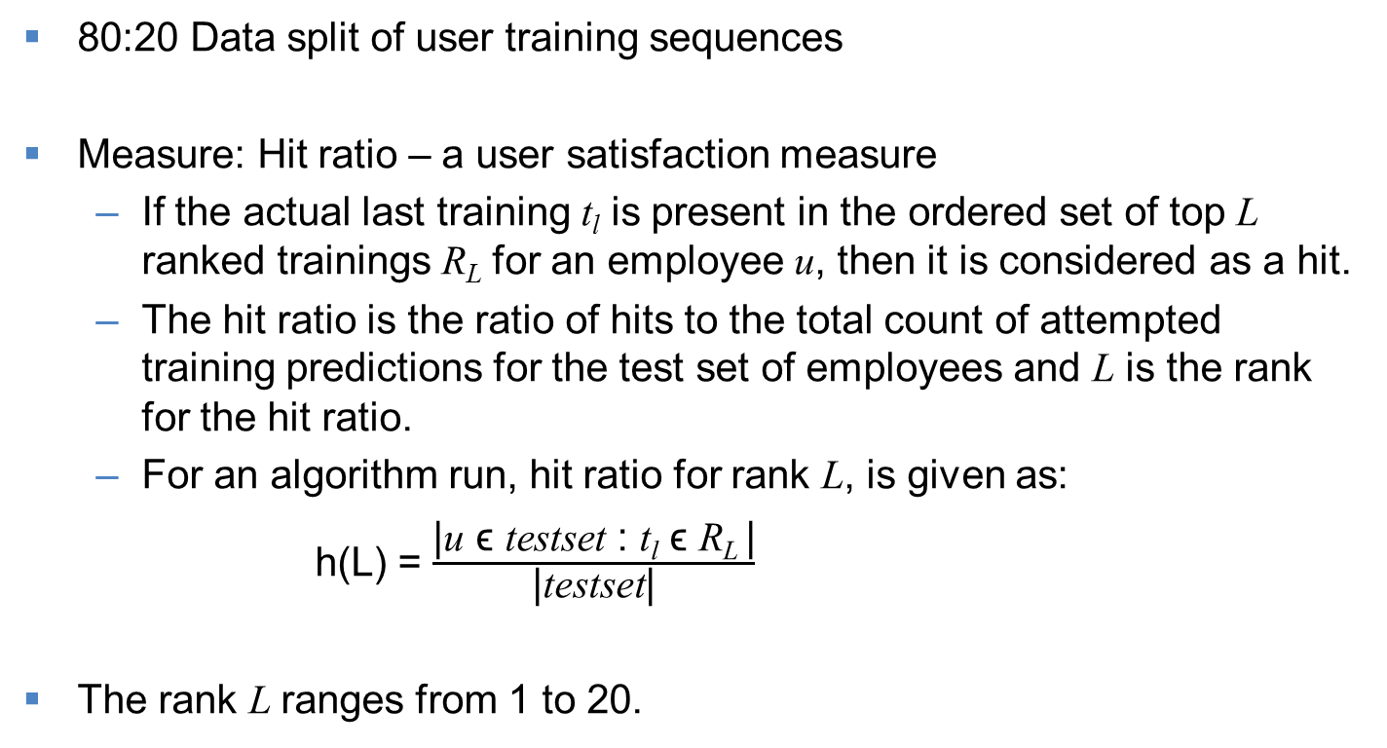
Experimentation set-up
80:20 Data split of user training sequences
Measure: Hit ratio – a user satisfaction measure
  If the actual last training t_{l} is present in the ordered set of top L ranked trainings R_{L} for an employee u, then it is considered as a hit.
  The hit ratio is the ratio of hits to the total count of attempted training predictions for the test set of employees and L is the rank for the hit ratio.
  For an algorithm run, hit ratio for rank L, is given as:
  h(L) = $\frac{\text{|}\text{u} \text{ϵ} \text{testset}\text{ : }\text{t}\text{l} \text{ϵ} \text{R}\text{L} \text{|}}{\text{|}\text{testset}\text{|}}$
The rank L ranges from 1 to 20.

Slide 12
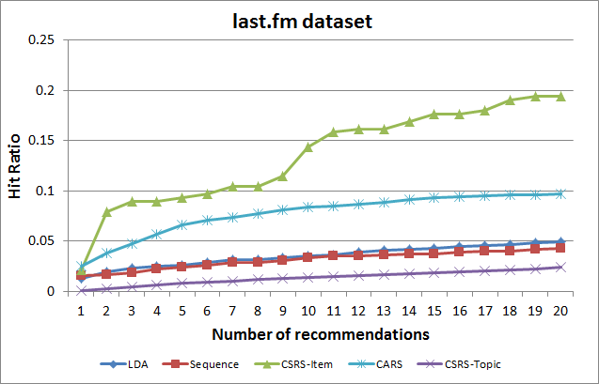
Results – last.fm dataset

Slide 13
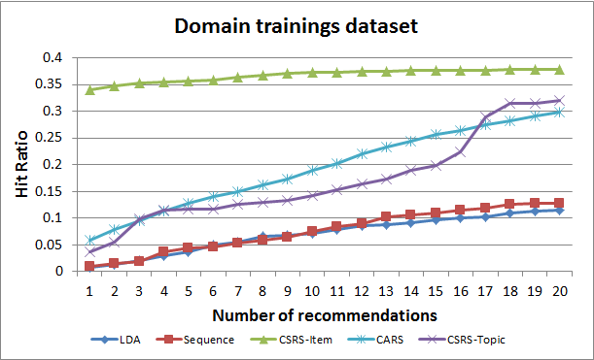
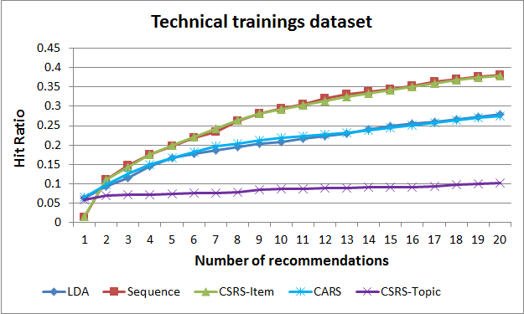
Results – Training dataset

Slide 14
Conclusions and Future Work
On last.fm and Domain trainings’ dataset Item-based CSRS outperforms other approaches
For the technical trainings’ dataset it matches the performance of sequence based model but is better than CARS and LDA based models
We can infer that incorporation of both, sequence as well as context improves hit-ratio of recommendation
Future Work
  Career path planning
  Recommend items such as trainings, certifications and projects

Slide 15
End
Thank-you.

Slide 16
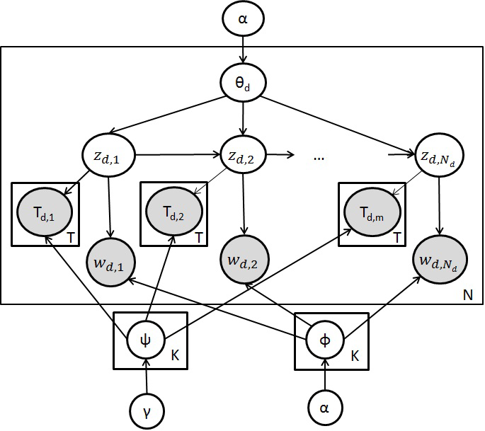
Context and Sequence aware Recommendation System
Topic sequence based
β

